Slide 1
BSc I YEAR
SUBJECT :CHEMISTRY
PAPER CODE: CHEM 101th

Slide 2
CHEM 101
SECTION A
QUANTUM NUMBERS AND SHAPES OF ORBITALS

Slide 3
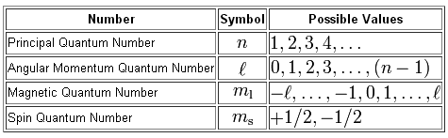
FOUR QUANTUM NUMBERS

Slide 4
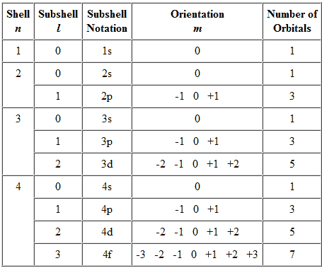
DESIGNATING QUANTUM NUMBERS

Slide 5
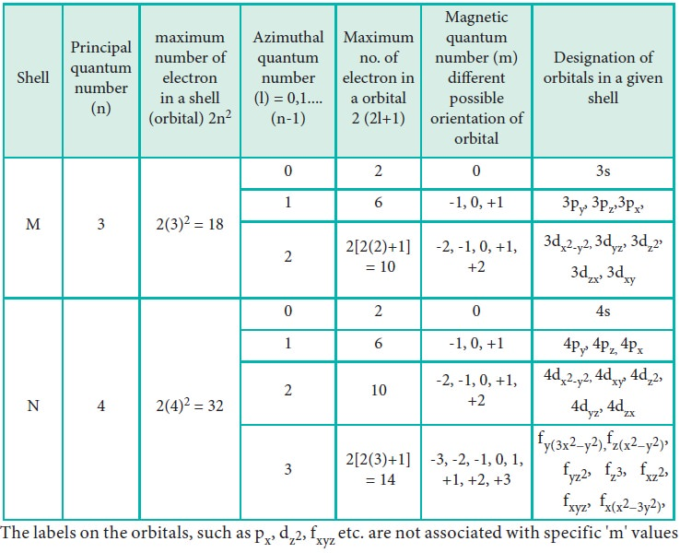
SOME FORMULAE

Slide 6
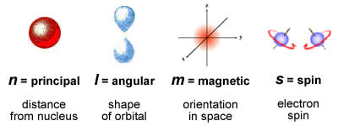
QUANTUM NUMBERS
WHAT THEY TELL?

Slide 7
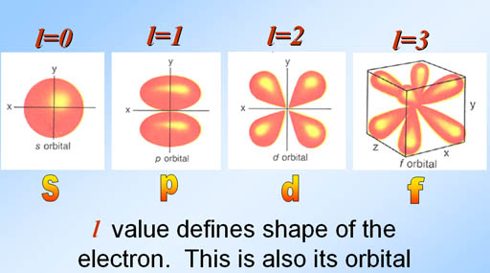
AZIMUTHAL QUANTUM NUMBER

Slide 8
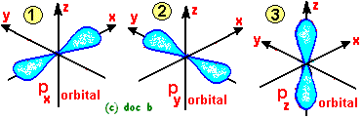
MAGNETIC QUANTUM NUMBER

Slide 9
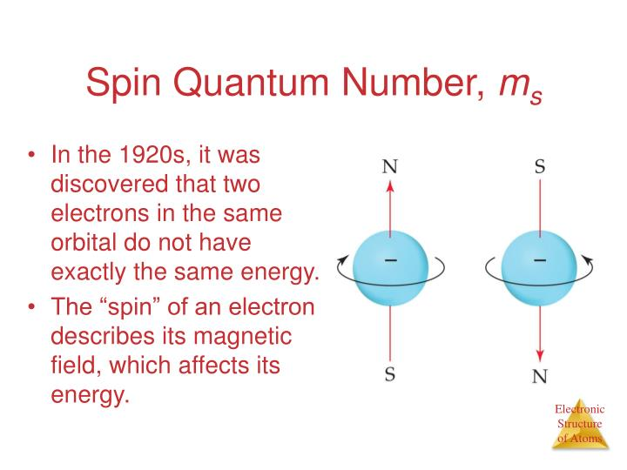
SPIN QUANTUM NUMBER

Slide 10
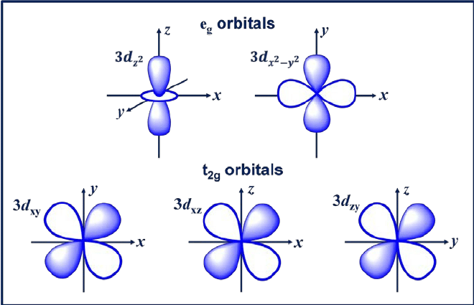
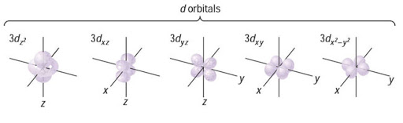
t_{2g} and e_{g} set of d orbitals

Slide 11
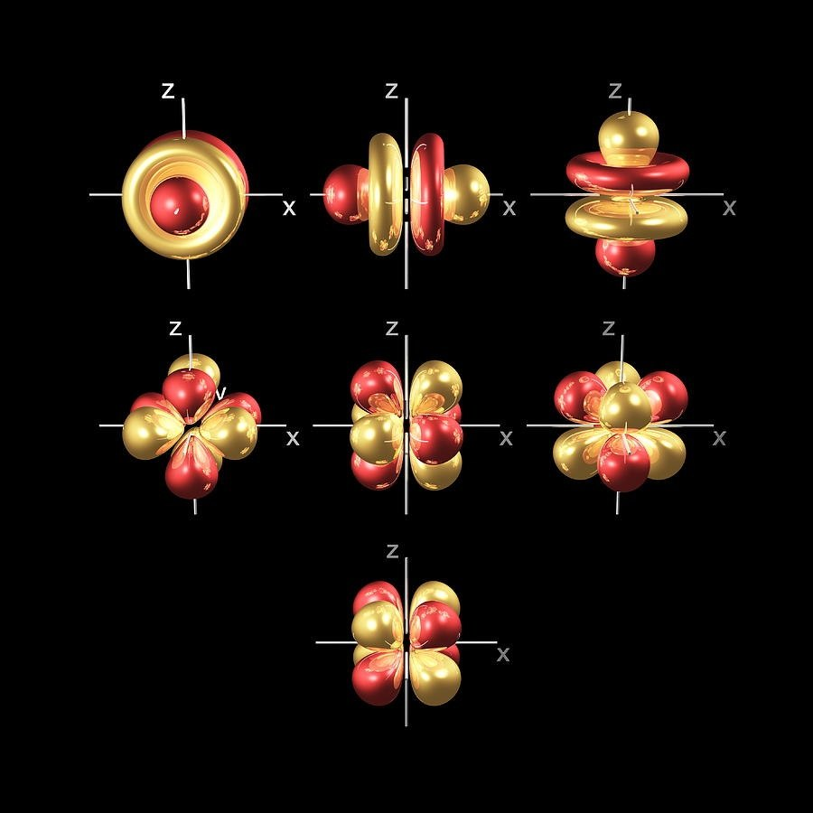
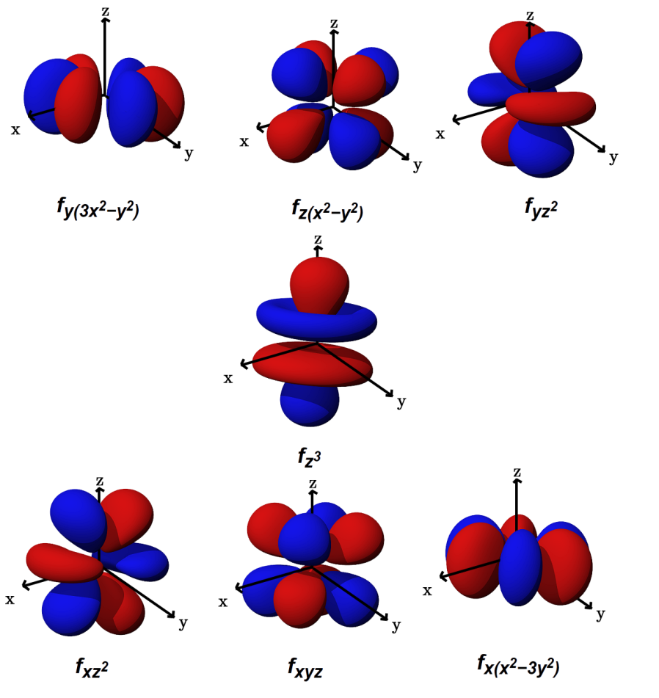
F orbitLS

Slide 12
Some Questions for home assignment.
Which of the orbitals do not exist and why:
3f, 2p,2d, 6f, 1p,8s.
Which of the following sets of quantum numbers are impossible for an electron in an atom?
4,2,0,+1/2
3,3,-2,-1/2
2,0,0,+1/2
4,0,1,-1/2
3,2,-2,0
Describe the orbitals in terms of their n+l value
3s,4d,5p
Are 5g and 6h subshells permissible?How many orbitals are possile in these subshells

